Slide 1

ANZ Bank Analytics Challenge: Team 3

Slide 2
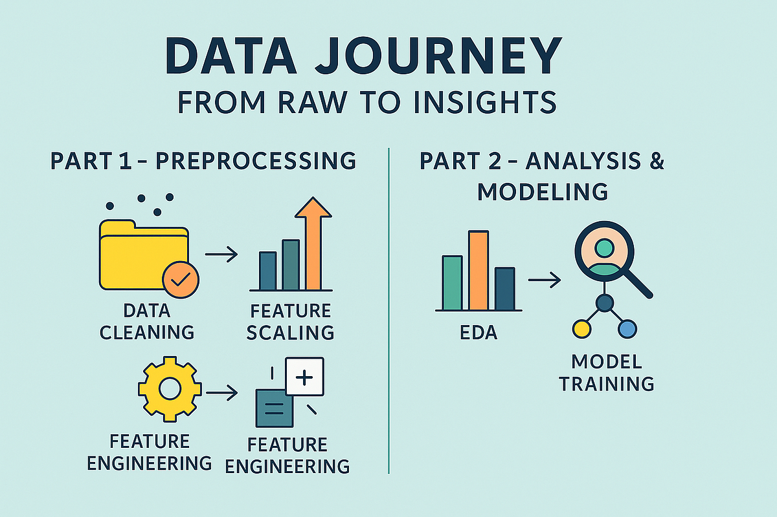
Agenda
The purpose of this analysis is to use raw data and we trained multiple models to predict loan defaults so the bank can approve safer loans and reduce financial risk.
Exploratory Data Analysis
Model Comparison
Model Evaluation
Business Insights

Slide 3
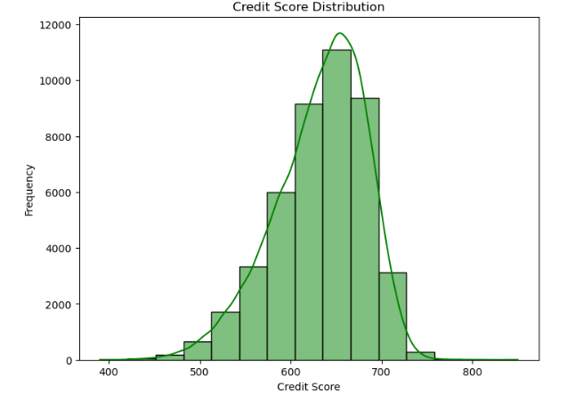
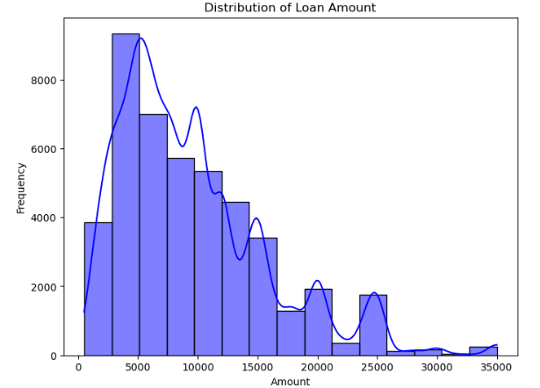
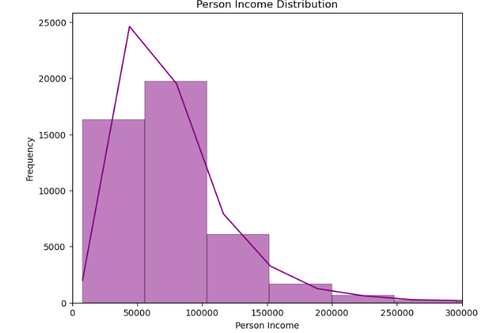
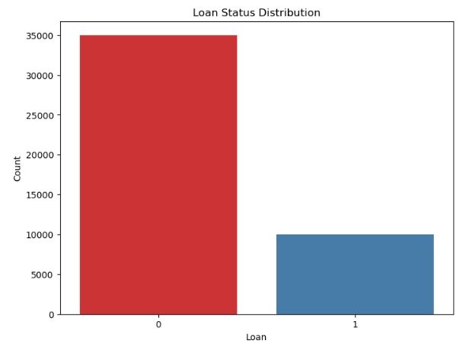
Exploratory Data Analysis (EDA)
Credit score Distribution
Most credit scores fall between 600 and 700, with the highest concentration around 650, indicating that many borrowers have moderate credit scores.
Loan Amount Distribution
The histogram shows that most customers take small to medium loans, mainly between $3,000 and $12,000.
Income Distribution Explanation
The income distribution is positively skewed, with most individuals earning between 30,000 and 100,000.
Count Plot
The number of applicants with loan status 0 (approved) is significantly higher than those with loan status 1 (not approved).

Slide 4
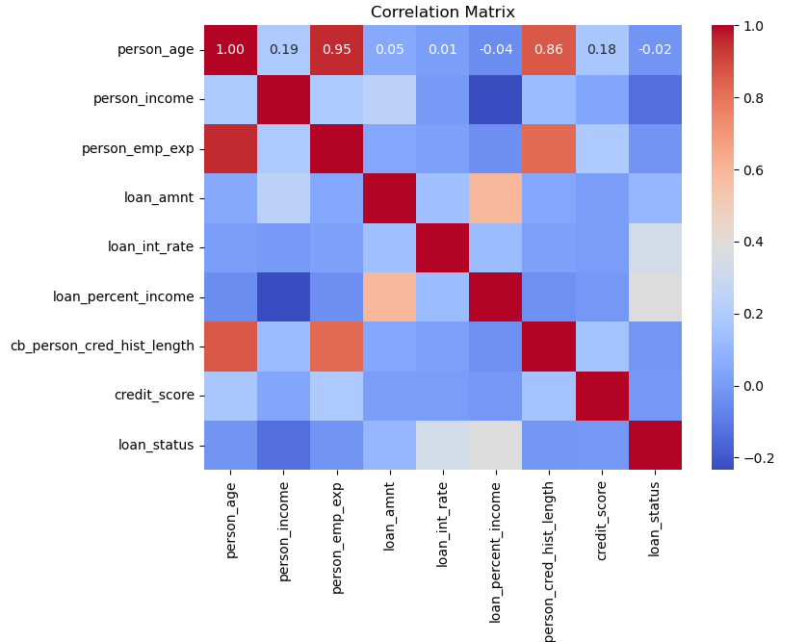
Exploratory Data Analysis (EDA)
Positive Correlation
person_age ↔ person_emp_exp (0.95): As age increases, employment experience also increases.
person_age ↔ cb_person_cred_hist_length (0.86): Older people tend to have a longer credit history.
loan_amnt ↔ loan_percent_income (~0.60): Higher loan amounts usually take up a larger percentage of a person’s income.
Negative Correlation
person_income ↔ loan_percent_income (~-0.25): People with higher income spend a smaller percentage of their income on loans.
person_income ↔ loan_status (negative): Higher income slightly reduces the likelihood of negative loan outcomes.
loan_int_rate ↔ person_income (negative): Individuals with higher income tend to have slightly lower interest rates

Slide 5
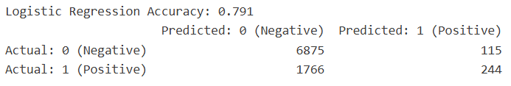
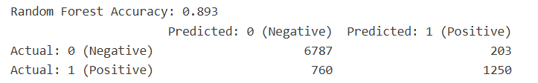
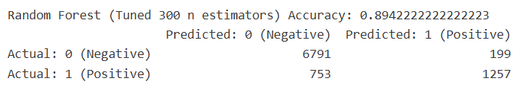
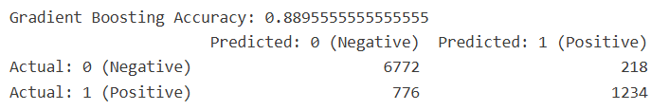
Model Comparison
Logistic Regression Model
Only 244 defaults correctly predicted, whereas 1766 defaults missed.
Random Forest Model
It correctly classified 6787 approved loans and 1250 defaulted loans.
Tuned Random Forest Model
It correctly predicted 6791 approved loans and 1257 defaulted loans.
Gradient Boosting Model
It correctly identified 6772 safe loans and 1234 loan defaults.

Slide 6
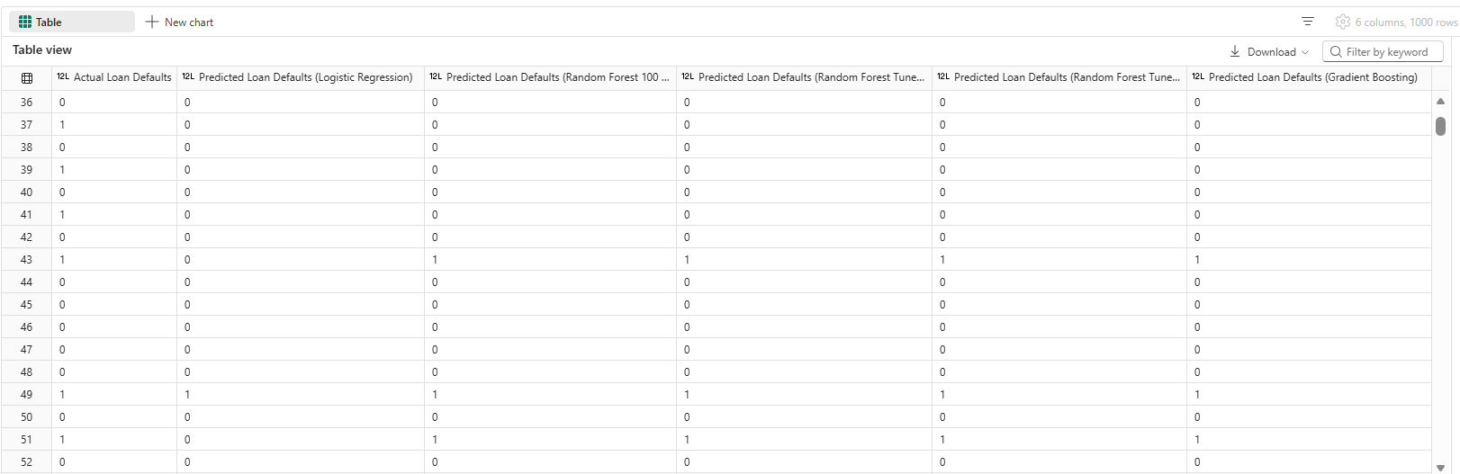
Model Evaluation
Among the three models tested, Random Forest performed the best.
It achieved the highest accuracy of 89.4% and correctly identified 1257 loan default cases, which is higher than Gradient Boosting and Logistic Regression. Additionally, it produced fewer missed default predictions compared to the other models. This indicates that Random Forest is more effective at identifying risky borrowers and is therefore the most suitable model for loan default prediction in this dataset.

Slide 7

Business Insights
ANZ Bank should implement predictive machine learning models such as **Gradient Boosting and **Random Forest in their loan approval system to improve credit risk assessment.
The bank can use these models to identify high-risk customers early, helping reduce loan defaults and financial losses.
Machine learning predictions can also support faster and more consistent loan approval decisions compared to manual assessments.
The bank should continuously update and retrain the models with new customer data to maintain accuracy and adapt to changing financial behavior.

Slide 8

Thank You
Presenter Names:
Harprabhjot Kaur Walia
Kamaldeep Kaur Saini
Sayan Tarafdar

